Slide 1
MACHINE LEARNING APPLICATION FOR CROP PREDICTION AND EFFICIENT FERTILIZER RECOMMENDATION USING PYTHON

Slide 2
MACHINE LEARNING APPLICATION FOR CROP PREDICTION AND EFFICIENT FERTILIZER RECOMMENDATION USING PYTHON
By
MUKTESWAR REDDY B 11716082
SAI SAHITH REDDY M 11716090
SWETHA K 11716097
Under the guidance of
Dr. P. Venkata Subba Reddy
HOD, Professor
Department of Computer Science and Engineering
Sri Venkateswara University College of Engineering

Slide 3
Contents
Introduction
Related Work
Existing system & its Disadvantages
Proposed System Methodology
Use case Diagram
Process Flow Diagram
Architecture Diagram
Model Selection, Training and Performance Evaluation
Accuracy Measures
Conclusion

Slide 4
INTRODUCTION
India has a large agricultural sector supporting majority of the population for their livelihood. Every year huge resources in terms of land and fertilizer are used for production of food.
Most of the fertilizer being used in farms today is being wasted due to the incorrect use of type of fertilizer. We are developing a machine learning model that analyses various soil features like Calcium, Iron concentration ,pH of soil and various other features to recommend the type of fertilizer to use and also the type of crop needed for particular area for maximum benefit.
The aim of this project is to take in features like annual rainfall, pH of soil , humidity, temperature of particular land area and train a machine learning model for accurate prediction of type of crop to be sown in order to get a good yield from crop. We also build a model to analyze soil features and recommend the type of fertilizer to be used.

Slide 5
Related Work
Niketa Gandhi et al ," Rice Crop Yield Forecasting of Tropical Wet and Dry Climatic Zone of India Using Data Mining Techniques",IEEE International Conference on Advances in Computer Applications (ICACA) , 2016.
Jharna Majumdar, Sneha Naraseeyappa and Shilpa Ankalaki, Analysis of agriculture data using data mining techniques: application of big data, Springer journal,2017.

Slide 6
Existing System & its Disadvantages
Farmers are growing same crops repeatedly without trying new variety of crops and they are applying fertilizers in random quantity without knowing the deficient content and quantity.
Existing system does not include the features like calculating the PH of soil , temperature, rainfall and humidity.
This is directly affecting on crop yield and also causes the soil acidification and damages the top layer.
Farmers will prefer the prior or neighborhood or more trend crop in the surrounding region only for their land and they do not have enough of knowledge about soil nutrients contents such as nitrogen, phosphorous and potassium in the land.

Slide 7
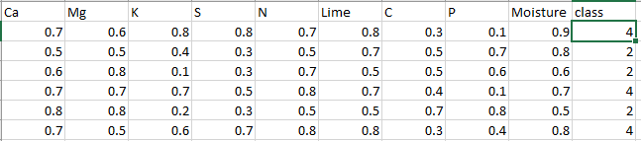
Proposed System Methodology
Soil Data Set
The dataset used for fertilizer recommendation is soil features dataset. It contains various features of soil like Calcium concentration, Magnesium concentration etc. The dataset contains total of more than 16500 datapoints. It has 9 features.

Slide 8
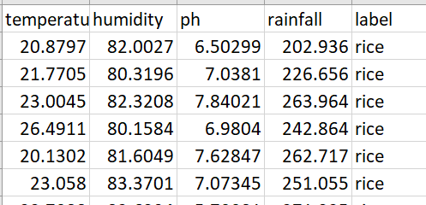
Proposed System Methodology
Land Cover Data Set
The dataset used for crop recommendation is the land cover dataset which includes features such as temperature, annual rainfall, pH of the soil and humidity. It has a target variable indicating the suitable crop. The dataset has a total of more than 15000 datapoints

Slide 9
Necessary Packages
Numpy
Pandas
Matplotlib
Scikit-learn
Data Preprocessing
This process includes methods to remove any null values or infinite values which may affect the accuracy of the system. The values are also rescaled for faster training of the models. Steps in preprocessing include outlier detection, missing value treatment, rescaling. Cleaning process is used for removal or fixing of some missing data there may be data that are incomplete

Slide 10
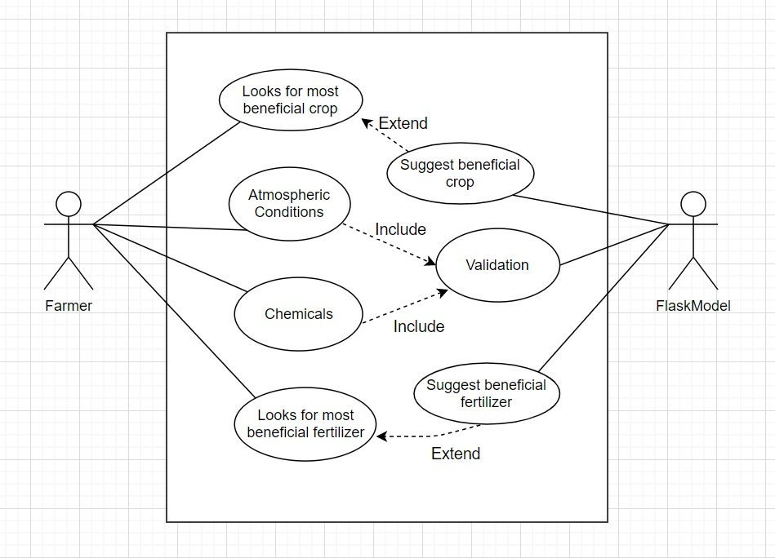
Use case Diagram

Slide 11
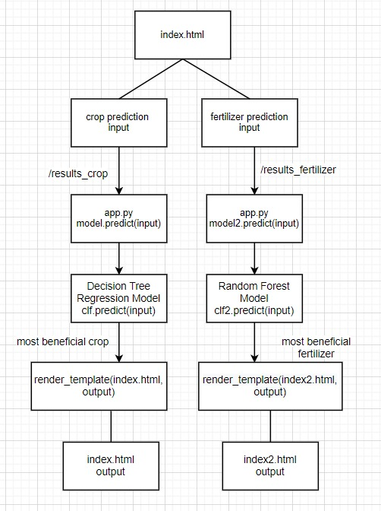
Process Flow Diagram

Slide 12
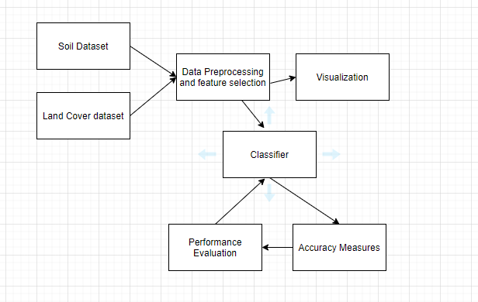
Architecture Diagram

Slide 13
Model Selection, Training and Performance Evaluation
After feature selection the dataset is divided into pair of xtrain ,ytrain and xtest, y test. The algorithm model is imported form sklearn. Building model is done using model. Fit (xtrain, ytrain).
Crop type and fertilizer type are our output (target). Since we are going to classify using continuous features, we are going to implement using Decision tree regression, support vector regression and also neural network based classifier.
After the model is build, prediction is done using model.predict(xtest). The accuracy is calculated using accuracy_score imported from metrics - metrics.accuracy_score (ytest, predicted).

Slide 14
Crop Prediction

Slide 15
Decision Tree Classifier
Decision tree builds regression or classification models in the form of a tree structure. It breaks down a dataset into smaller and smaller subsets while at the same time an associated decision tree is incrementally developed. The final result is a tree with decision nodes and leaf nodes.
A decision node has two or more branches each representing values for the attribute tested.
Leaf node represents a decision on the numerical target. The topmost decision node in a tree which corresponds to the best predictor called root node. Decision trees can handle both categorical and numerical data.
There are several steps in decision tree: 1) Splitting 2) Pruning 3) Tree Selection

Slide 16
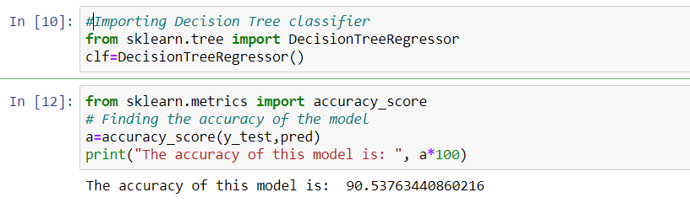

Slide 17
Support Vector Machine
SVM or Support Vector Machine is a linear model for classification problems. It can solve linear and non-linear problems and work well for many practical problems. The algorithm creates a line or a hyperplane which separates the data into classes. The linear SVM classifier works by drawing a straight line between two classes. All the data points that fall on one side of the line will be labelled as one class and all the points that fall on the other side will be labelled as the second

Slide 18
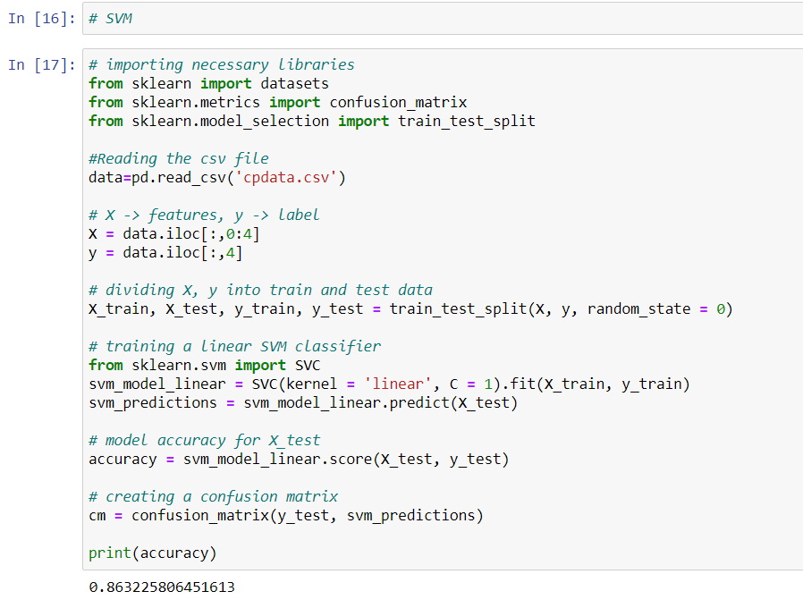

Slide 19
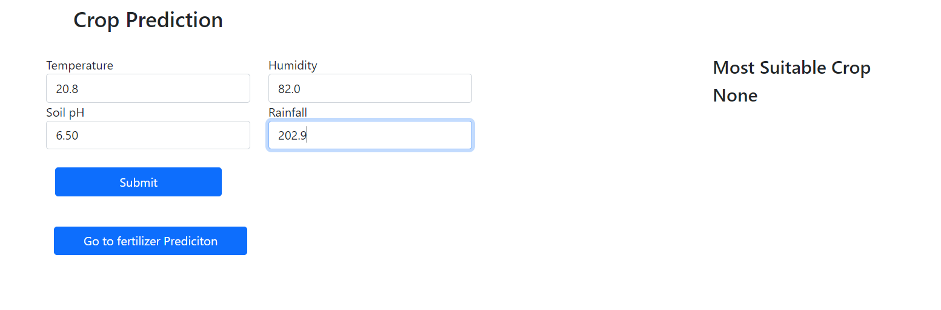
Input for Crop Prediction

Slide 20
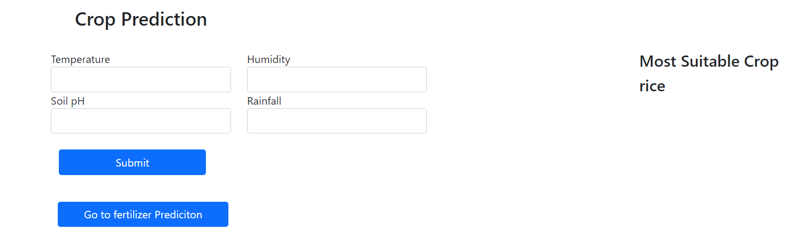
Output for Crop Prediction

Slide 21
Fertilizer Recommendation

Slide 22
Neural Network
A simple neural network includes an input layer, an output (or target) layer and, in between, a hidden layer. The layers are connected via nodes, and these connections form a “network”.
The input layer picks up the input signals and transfers them to the next layer. It gathers the data from the outside world. The hidden layer performs all the back-end tasks of calculation. A network can even have zero hidden layers. However, a neural network has at least one hidden layer. The output layer transmits the final result of the hidden layer‟s calculation.

Slide 23
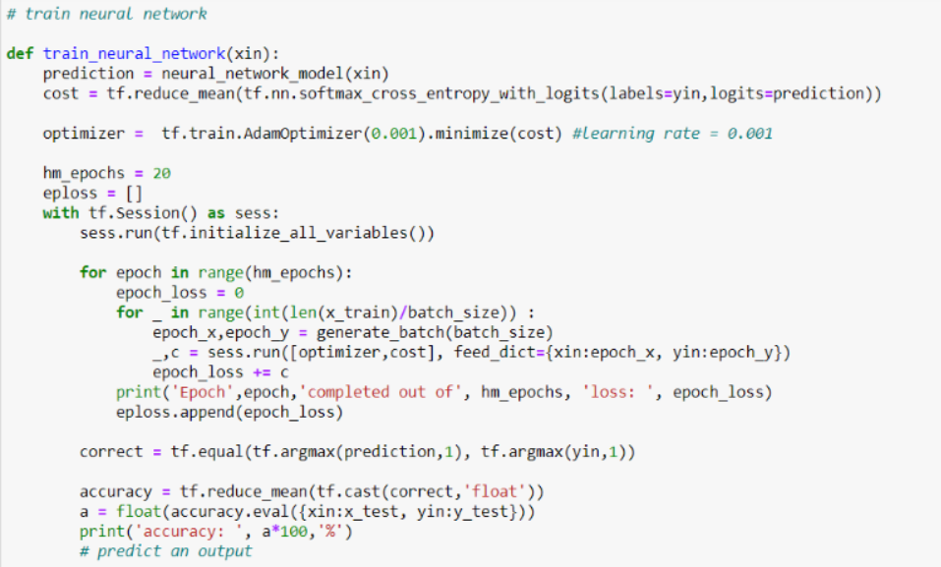

Slide 24
Random Forest Classifier
Random Forest is a popular machine learning algorithm that belongs to the supervised learning technique. It can be used for both Classification and Regression problems in ML.
It is based on the concept of ensemble learning, which is a process of combining multiple classifiers to solve a complex problem and to improve the performance of the model.
Random Forest is a classifier that contains a number of decision trees on various subsets of the given dataset and takes the average to improve the predictive accuracy of that dataset.

Slide 25
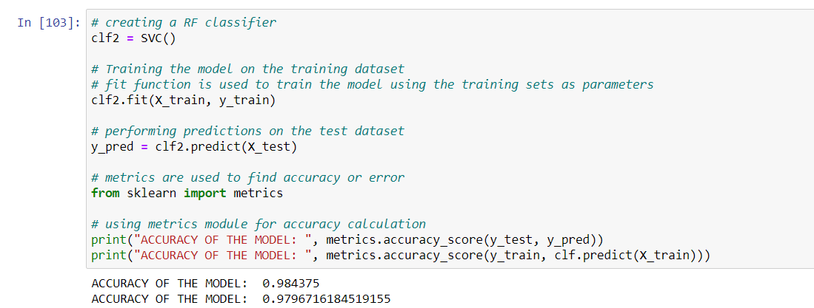

Slide 26
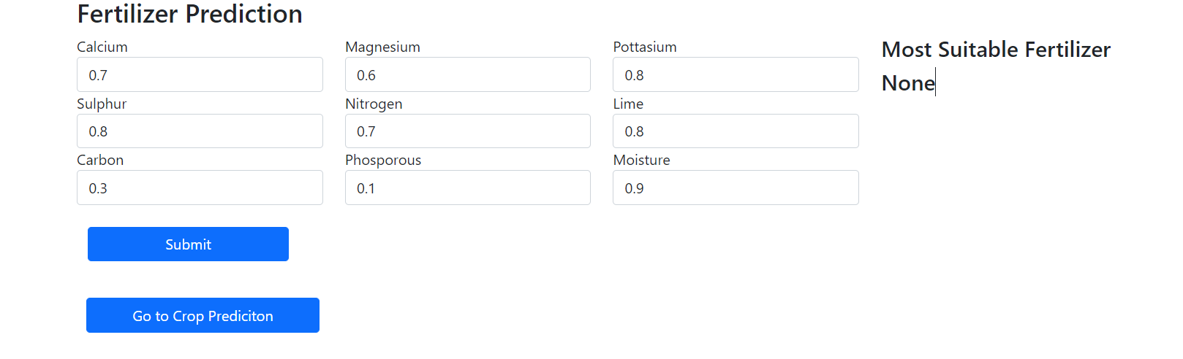
Input for Fertilizer Recommendation

Slide 27
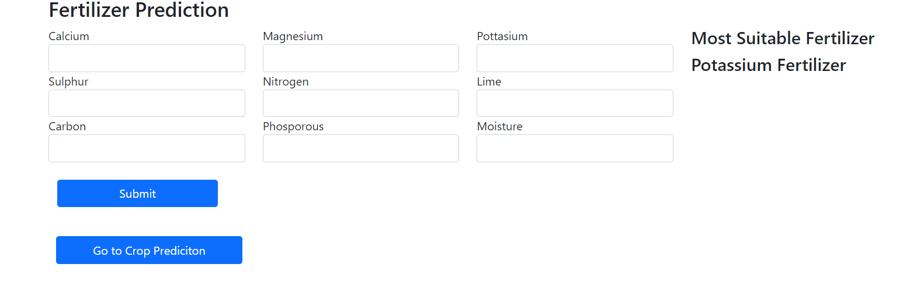
Output for Fertilizer Recommendation

Slide 28
Accuracy Measures Most Suitable Crop Yield:
1) SVM: Accuracy of SVM model is 86.32 percent. 2) Decision Tree Classifier: Accuracy of this model is 90.645 percent which is higher than SVM model. 3) Neural Network: the accuracy is of this model is 71.94 which is very less than SVM and Decision Tree Classifier models. Most Beneficial Fertilizer Recommendation: 1) Neural Network: After training for 20 epochs the accuracy was 89.58 percent 2) Random Forest: For training data, the accuracy was 97.96 percent and for testing data it is 98.43 percent which is higher and better than neural network model.

Slide 29
CONCLUSION
Presently our farmers are not effectively using technology and analysis, so there may be a chance of wrong selection of crop and fertilizers for cultivation that reduce their income.
We select the models with highest possible accuracy and the accuracy is measured with various metrics like K-fold, precision, recall. We intend to develop this model so that it is beneficial for farmers in decision making for good farm produce.

Slide 30
THANK YOU

